Slide 1
Railways Ticketing System

Slide 2
CONTENTS
Introduction
ER Diagram and Schema
Glimpse of the database
Price trends
Age groups distribution across routes
Variance in the Fuel Multiplier
Revenue comparison across the corporate and individual accounts
Conclusion

Slide 3
Introduction to Railways Reservation System
The railway reservation system facilitates the passengers to enquire about the trains available based
on source and destination, booking and cancellation of tickets, enquire about the status of the booked ticket, etc.
This project contains an introduction to the railway reservation system. It is the computerized system of reserving the seats of the train in advance.
The aim of this project is to design and develop a database maintaining records of different trains,
ticket details, customer details, the discount rate applied, train routes, and stations.
Railway reservation system, as described above, can lead to error-free, secure, reliable, and fast
management system.

Slide 4
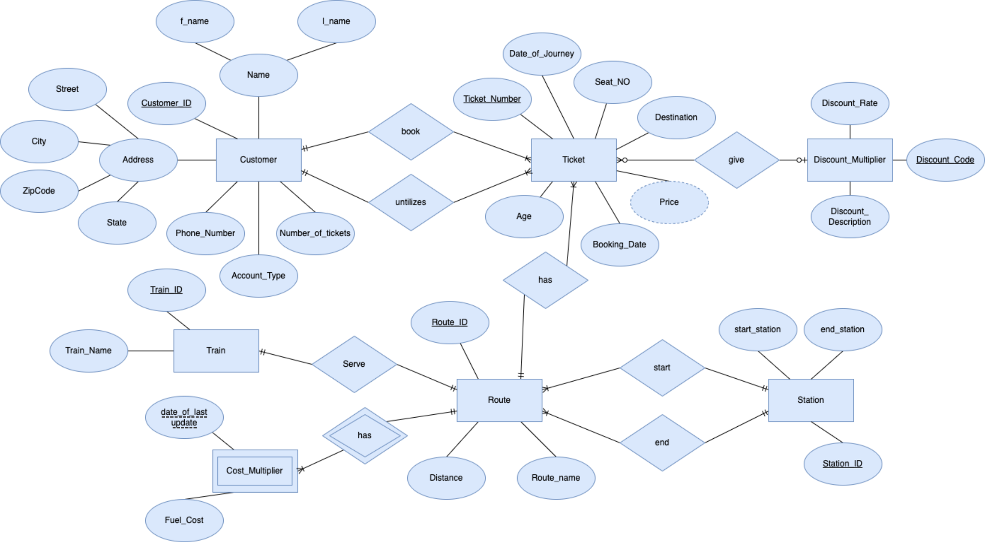
ER Diagram

Slide 5
Features of Railways Reservation System
We have created 6 entities. Each gives different details of the reservation system:
Route: This entity gives details about 10 routes and corresponding distances.
Ticket: This entity gives all the details about tickets, mainly, purchaser and rider information, booking and journey dates, destination, and the allocated seat number.
Customer: This entity gives all the details about every customer.
Train: It contains information about trains on each route.
Station: This contains information about starting and end stations of each train in each route.
Discount: This stores information about discount rates.
Cost Multiplier: This is the weak entity that stores information about fuel costs for each route, which is used for ticket price calculation.

Slide 6
ER Diagram Schema
Customer (Customer_ID, f_name, l_name, Phone_Number, Street, City, State, ZIPCode, Number_of_tickets,
Account_Type)
2. Ticket (Ticket_Number, Date_of_Journey, Date_of_Booking, Seat_Number, Destination, Age, Rider_ID[FK], Customer_ID[FK], Route_ID[FK], Discount_Code[FK])
3. Route (Route_ID, Route_Name, Distance, Station_ID[FK], Train_ID[FK])
4. Station (Station_ID, start_station, end_station)
5. Train (Train_ID, Train_Name)
6. Cost_Multiplier (Date_of_last_update, Fuel_cost, Route_ID[FK])
7. Discount(Discount_Code, Discount_Rate, Discount_Description)
Cardinality:
Mandatory One to Mandatory Many : Route to Ticket, Customer to Ticket, Station to Route, Route to Cost Multiplier
Optional One to Optional many : Discount to Ticket
One to One : Route to Train

Slide 7
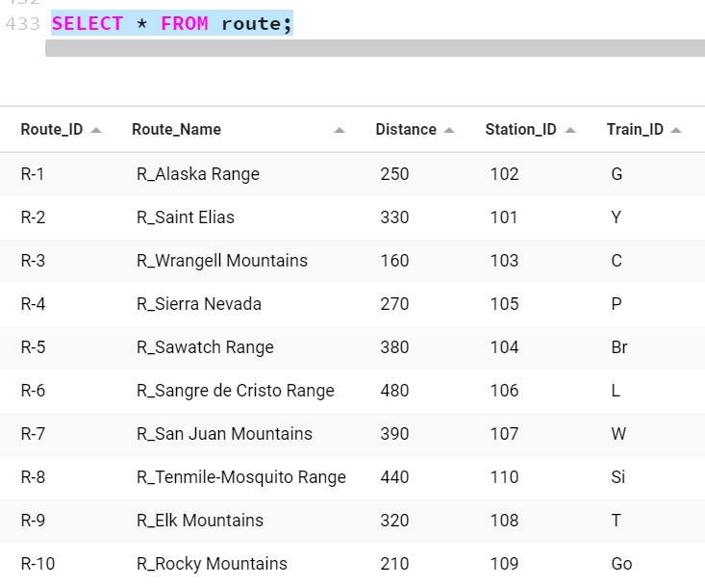
GLIMPSES OF THE DATABASE
ROUTE TABLE

Slide 8
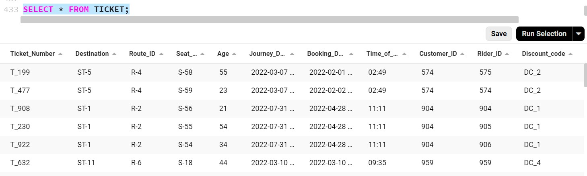
TICKET TABLE

Slide 9
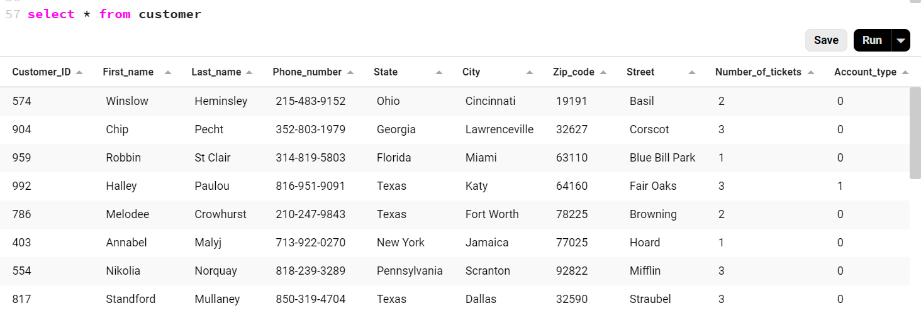
CUSTOMER TABLE

Slide 10
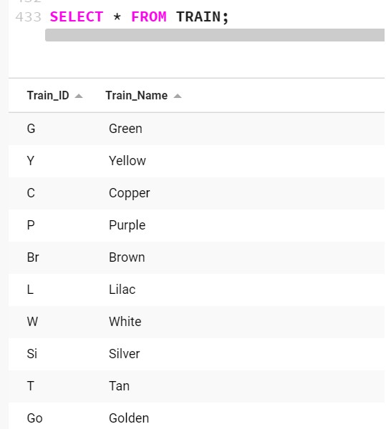
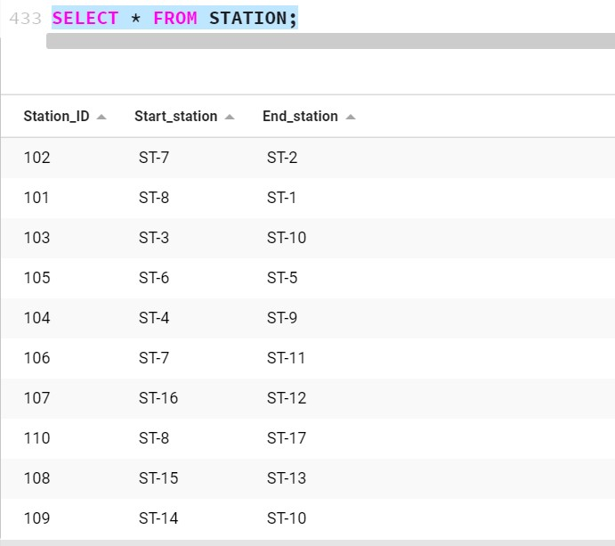
STATION TABLE
TRAIN TABLE

Slide 11
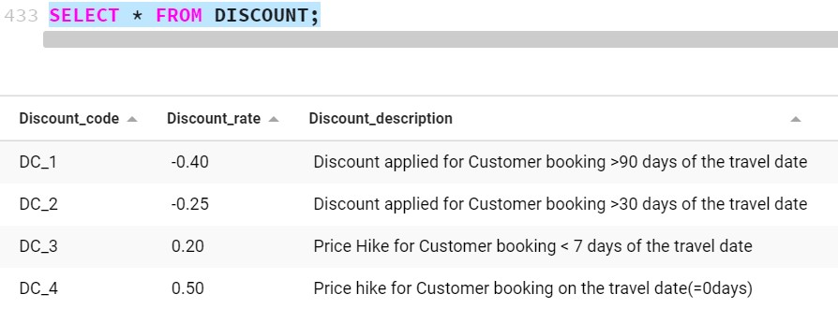
DISCOUNT TABLE

Slide 12
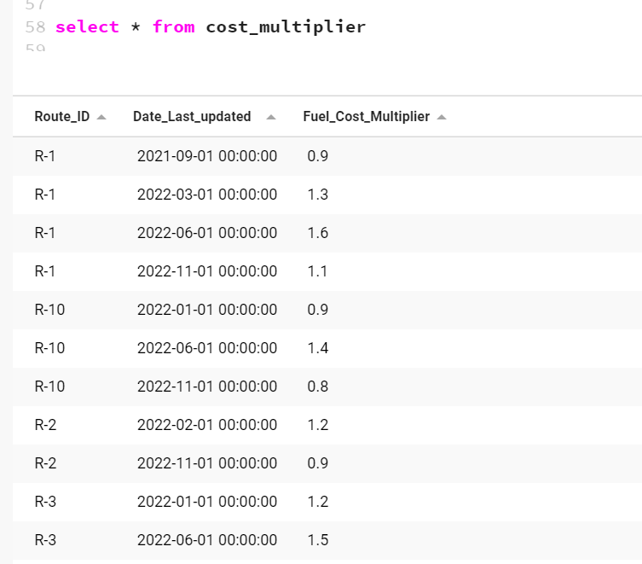
COST_MULTIPLIER TABLE

Slide 13
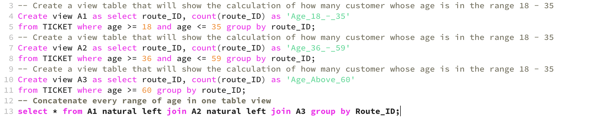
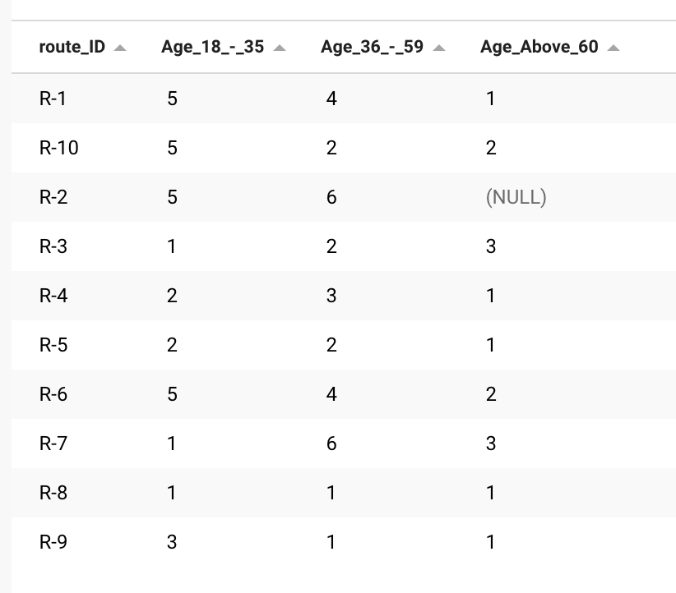
SQL Queries : Age Distribution Across All Routes
Age Distribution Table
Purpose:
Create a view table that will show age distribution among the passengers within range of age groups across all routes.
Steps:
Create 3 different view tables
Concatenate all of the three view tables

Slide 14
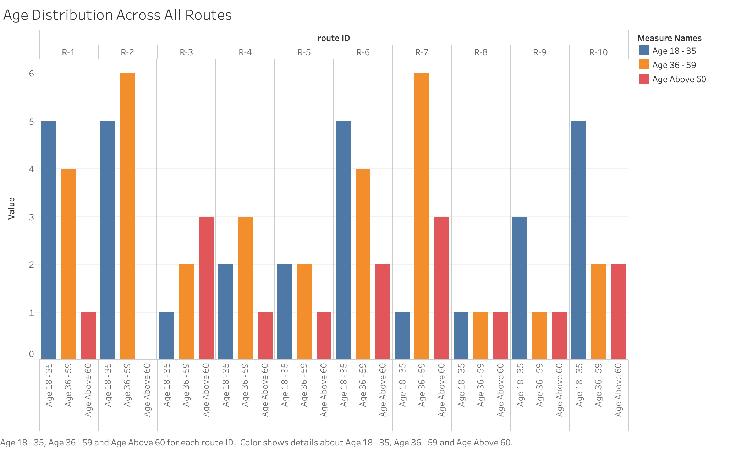
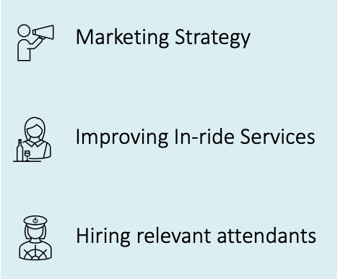
SQL Queries : Age Distribution Across All Routes
Business Uses:

Slide 15
PRICE TREND ANALYSIS
What Affects Ticket Prices?
Ticket Prices Change With the Season
Ticket Prices are Based on Fuel Cost
Prices Drop When There’s More Competition
Longer Distances Lead to Higher Fares
Business Travelers Affect Ticket Prices
Booking Time Affects the Ticket Price
Why do we need Price Trend Analysis?
Finding Out Where You're Going
Find Out How You Compare
Find Out If You're Meeting Your Goals
Integrated Business Analysis

Slide 16
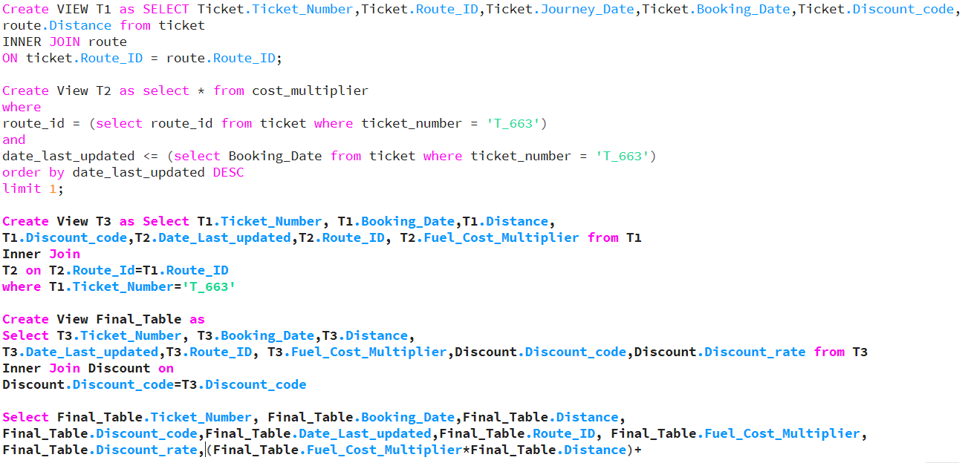
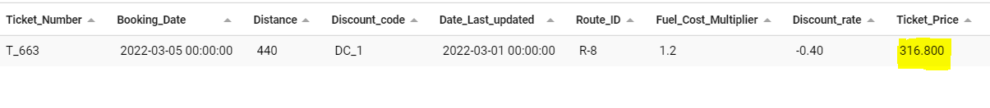
SQL Queries : Ticket Price Trend

Slide 17
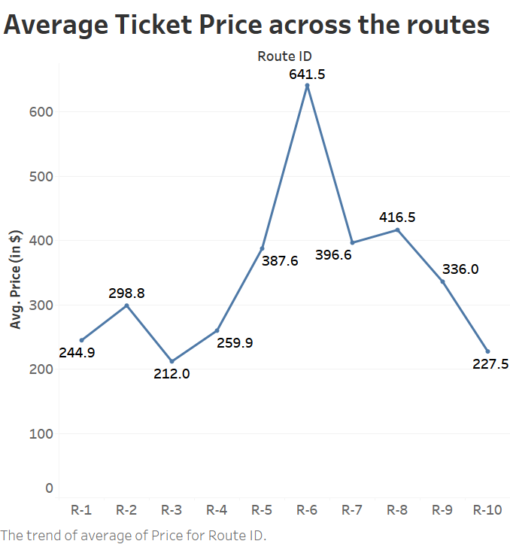
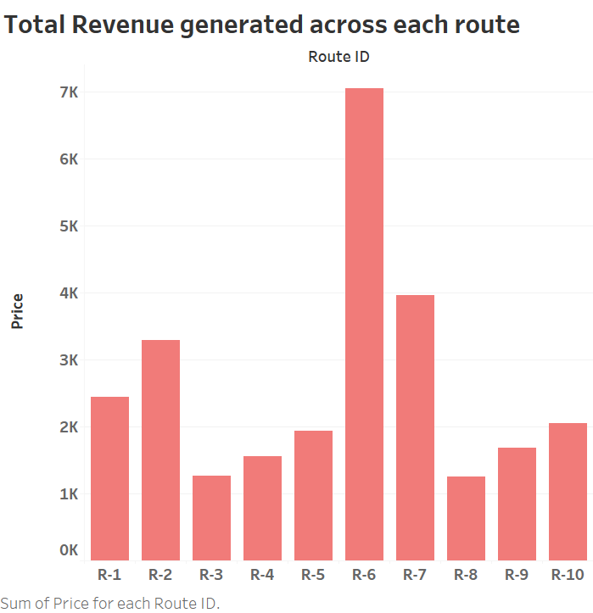
Ticket Price calculation output

Slide 18
Derived insights from Price analysis
Average Ticket Price analysis
Route 6 has highest average price 641.5 , followed by Route 8 with 416.5
Route 10 has lowest average ticket price 227.5
Total Revenue Generated across all routes
Route 6 generates highest revenue nearingly 7K followed by route 7 which generates 4K
Lowest Revenue generator is Route 8 with 1K
Conclusion
Most Popular route is Route 6 and Less popular route is Route 8

Slide 19
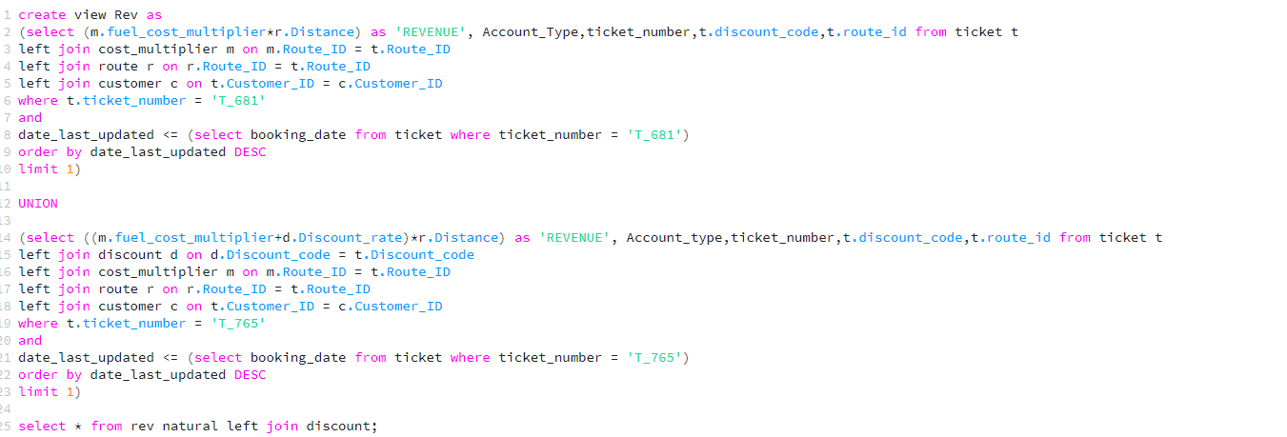
SQL Query 3: Revenue Comparison
Purpose:
To compare revenue generated from tickets booked through agents and individuals.
We have selected two tickets, T_765 and T_681 booked in Route number 7 for our analysis. T_765 is booked by Individual user(Account_Type=0) and T_681 is booked by Agent (Account_Type=1).
What can we do with this query?
Let’s see!

Slide 20
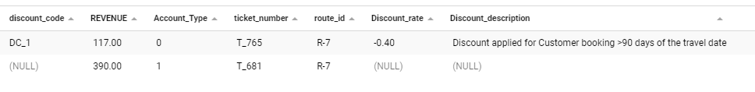
Result:
On execution of query we observe that revenue generated through Agent account is higher than that of individual accounts.
Business Uses:
Agents can be an effective channel for new customer acquisition.Discount for agents can be worked out so that they will bring in new customers to the railways.
Identify the routes where booking through agents is less and work on addressing any shortcomings in those routes.
Identify the routes where booking through agents is more and explore whether there is any scope for introducing additional services.

Slide 21
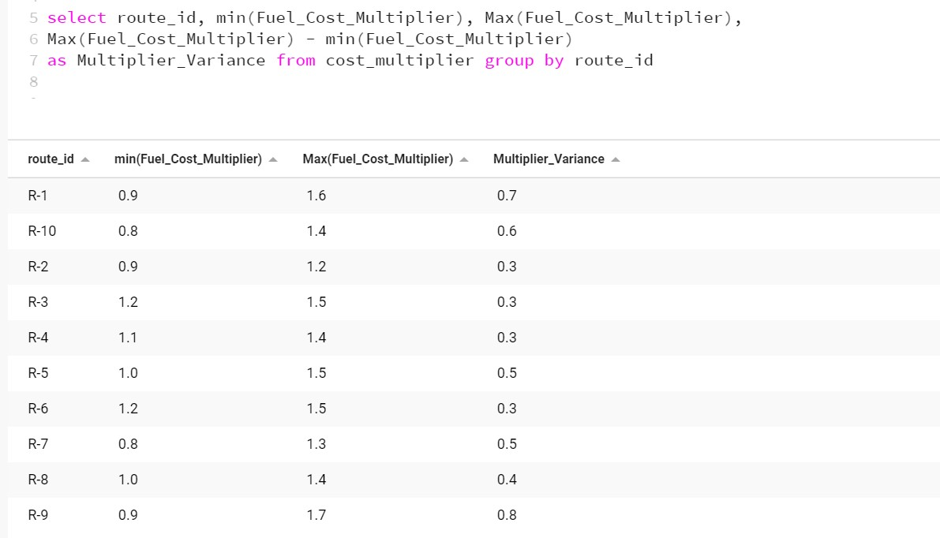
Variance in the Fuel Cost Multiplier

Slide 22
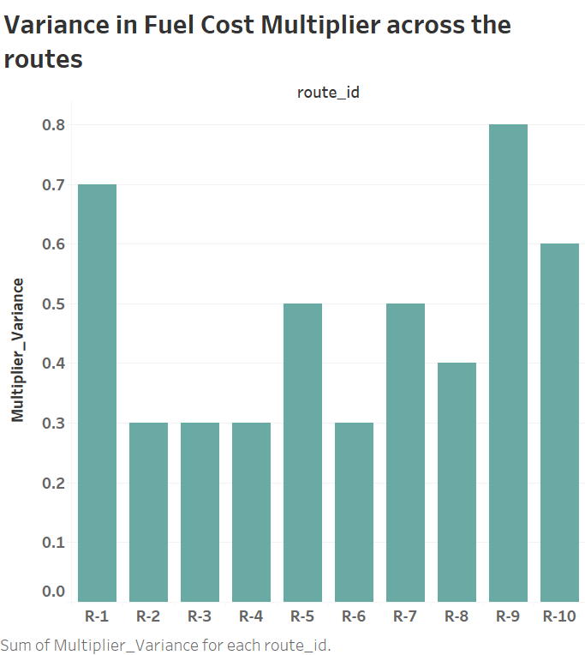
Cost Multiplier plays an important role in determining the ticket prices.
It makes the prices dynamic
We have calculated the fuel cost fluctuation in different routes. Here we have tried to show variations ,we can see that with respect to each route what is the min and max fuel multiplier and variance .
We can see which route had higher number of price fluctuations , understand how many travellers travel when the multiplier was low and high
This helps us to price the routes better looking at the demand and fuel costs at that particular.

Slide 23
CONCLUSION
From all these elementary analysis and starter queries we shown, we can draw few reasonable conclusions:
· Passenger traffic
· Ticket Pricing strategies
· In-ride facilities based on age grouping
· Pricing differences between account types
When reading through the trend analysis, With the real-time data which is more structured and informative, we get useful and interesting insights and that helps us improve our pricing strategy and generate clear picture about gains and losses incurred.

Slide 24
THANK YOU

